Slide 1

Travel Package purchase prediction
By, Sonali D.

Slide 2
Objective:
Development of a predictive model for prediction of travel package purchase. The model will determine whether a customer will buy a travel package or not. This will help to understand specially on which customers to be focused more and where we need better ideas to be implemented instead of applying the same methodology to all customers.
Benefits:
Information about loyal customers and where the sales team to be more focused on.
Gives better insight of customers base.
Helps in easy flow for managing resources.
Idea’s to take actionable steps based on the results.

Slide 3
Data Sharing Agreement :
Sample file name (ex Travel package purchase dataset)
Length of date stamp(8 digits)
Length of time stamp(6 digits)
Number of Columns
Column names
Column data type

Slide 4
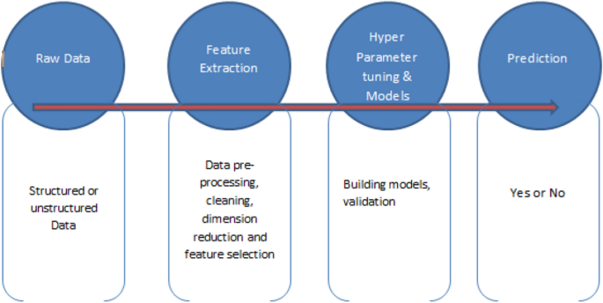
Architecture- Proposed methodology

Slide 5
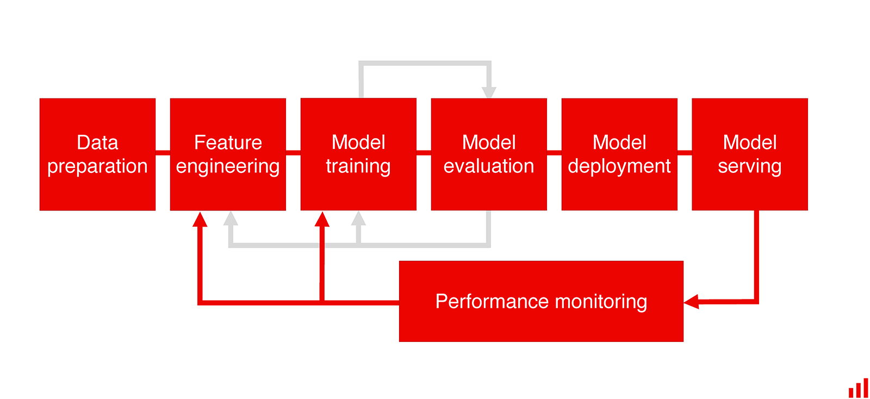
Model Training and Evaluation

Slide 6
Data Transformation :
What is transforming data?
Both ETL and ELT processes have the letter “T” which stands for “transform. "During the transform step, we will perform three categories of transforms:
1. Manipulate the form of the data
This type of data transformation is an opportunity to form the data such that it is suitable for an intended purpose. Specific examples might be removing duplicate values; or handling missing values.
The goal is to have a set of data ready to be analyzed whether in a report, a statistical model, or a machine learning model.
2. Engineer features in the data
This type of data transformation generates new data values based on existing values. This is an important step for many advanced statistical and machine learning modeling exercises. Examples of feature engineering include creating new variables; replacing values; or combining or splitting values.
The goal is to generate appropriate columns of data to help an applied statistician or machine learning engineer create efficient, effective models for answering explicit questions about the data.

Slide 7
3. Transform data values
The last type of data transformation involves modifying data values to create a distribution appropriate for analysis. For example, a set of values in a dataset might be severely skewed or be inconsistently scaled. Examples of transforming data values include log, square root, or cube transformations; data standardizing or normalizing; or outlier removal.
The goal is to create data values suitable for various statistical and machine learning algorithms.

Slide 8
Data Insertion in Database:
Table creation :- Table name “travel_package" is created in the database for inserting the files. If the table is already present then new files are inserted in the same table.
Insertion of files in the table - All the data are inserted in the above-created table. If any file has invalid data type in any of the columns, the file is not loaded in the table

Slide 9
Model Training:
Data Export from Db :
The accumulated data from db is exported in csv format for model training.
Data Preprocessing
Performing EDA to get insight of data like identifying distribution , outliers ,trend
among data etc.
Check for null values in the columns. If present impute the null values.
Encode the categorical values with numeric values.
Remove Outliers from data
Perform Feature scaling to scale down each feature or variables.

Slide 10
Model Selection –
We find the best algorithm for our data model. Various algorithms have been used such as Decision tree , Random forest classifier ,Bagging classifier , Naïve Bayes classifier , Gradient Boost, XGBoost , Stacking techniques. For each technique their hyper tunned algorithms are used. We calculate the Accuracy, recall,precision,F1 score, AUC scores for all the models and select the model with the best score. Similarly, the best model is selected. All the models for are saved for use in prediction

Slide 11
Prediction:
The testing files are shared in the batches and we perform the same Validation operations ,data transformation and data insertion on them.
The accumulated data from DB is exported in csv format for prediction
We perform data pre-processing techniques on it.
Various ensembles techniques are used such as Bagging, Boosting and Stacking which reduces variance and provide higher stability with minimizing errors
Various algorithms are used such as Decision tree , Random forest classifier , Naïve Bayes classifier , Gradient Boost, XGBoost to create data model and the best model is selected as per AUC score is loaded and is used to predict the answers.
Once the prediction is done it is then saved and a report is created by visualizing the data.

Slide 12
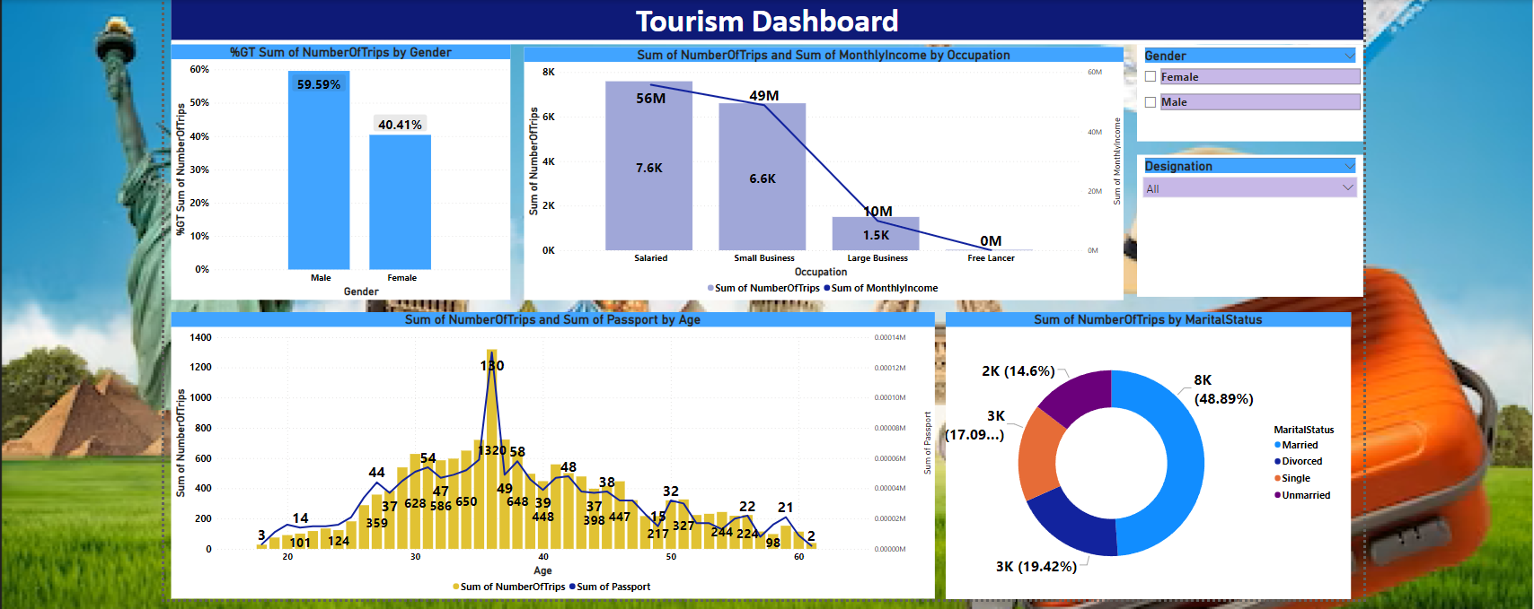
Visualizing Data

Slide 13
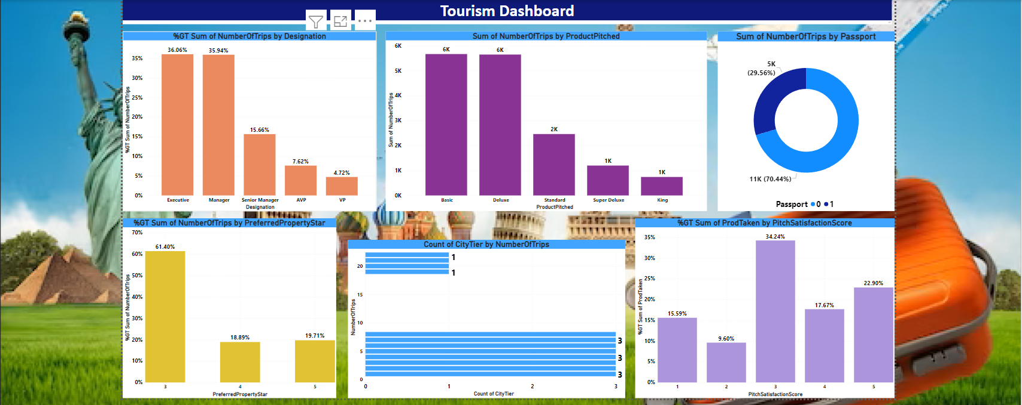

Slide 14
Business Insights
Passport holders, Executive level , Married people and Men customers are more likely to accept a package deal.
However, the current customer base has 70.44% Non-Passport holders and only 17.09% of customers are single compared to 48.8% are married.
So we can come one with new marketing idea's or advertisement to attract the single persons and can encourage non passport holders.
We can give discounts or coupons to existing or regular customer's to retain or increase the frequency of traveling and to attract more customers holding passport.
Currently, the Executive level customers dominated the share of customers at 36.06% and more can be done to increase the number.
Comments on additional data sources for model improvement
The model implemented will help to understand specially on which customer's to be focused more and where we need better ideas to be implemented instead of applying the same methodology to all customers. This will increase revenue and reduce marketing costs.

Slide 15
Other Recommendations – From EDA
Around 40.4% female are taking trips which is lower compare to men taking trips, this may be due to many reasons so we could look into it to attract more females by arranging feedback surveys or female group trips.
61.4% people are using 3 start property so 4 and 5 star hotel can come up with some marketing strategy to attract more customers.
More expansion is needed among Tier 2 residents as as preferred city Tier is 3 for customers.
More expansion is needed on Large business customers now at 8.9% of our customer base.
Basic and Delux properties are most preferred, so Standard, super delux and King property marketing needs to be improved to attract more customers.
Comments on additional data sources for model improvement
Additional data can be gathers from the people who are enquiring but not taking the package, they can be asked to fill a feedback survey asking for why they will not select the package from that we will get insight and further analysis to build a strong model or improvements can be done.

Slide 16
Sales teams should be briefed to at least have 3 follow-ups with potential customers.
The new package has to have similar features to Basic, Standard and Deluxe packages and marketed in 3 star or 5 star hotel combinations.
Further investigation on unusual high number of rating 1.0 to help improve sales conversion.
Super Deluxe package performs poorly and it should require a relook at its features and discontinued if needed. The new travel package should not have similar features to Super Deluxe package.

Slide 17
Q & A:
Q1) What’s the source of data?
The data for training is provided by the client in multiple batches.
Q 2) What was the type of data?
The data was the combination of numerical and Categorical values.
Q 3) What’s the complete flow you followed in this Project?
Refer slide 4th , 5th for better Understanding
Q 4) After the File validation what you do with incompatible file or files which didn’t pass the validation?
These are moved to the Achieve Folder and a list of these files has been
shared with the client and we removed the bad data folder.

Slide 18
Q 6) What techniques were you using for data pre-processing and how training was done or what models were used?
Removing unwanted attributes
Visualizing relation of independent variables with each other and output variables
Checking and changing Distribution of continuous values
Removing outliers
Cleaning data and imputing if null values are present.
Converting categorical data into numeric values.
The scaling was performed over training and validation data , Model building and Hyperparameter tunning
Various algorithms are used such as Decision tree , Random forest classifier , Naïve Bayes classifier , Gradient Boost, XGBoost to create data model and the best model is selected as per AUC score is loaded and is used to predict the answers
Finding out suitable model and predict business insights using it.

